Slide 1



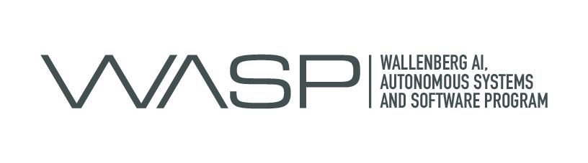
JFEATURE
Know Your Corpus !
Idriss Riouak, Görel Hedin, Christoph Reichenbach, and Niklas Fors
Computer Science Department, Lund University, Sweden.

Slide 2
Tool evaluation: why and how ?
Why ?
Measure how well our tool perform
Convince the reader that our tool is fast and precise
How ?
Software Corpus
a.k.a collection of real word projects

Slide 3
Problem: Which corpus should we use for the evaluation of our tool?
IT DEPENDS
The kind of tool
Compiler Front-end or Back-end
ML-based application
What we want to evaluate ?
Performance
Precision
…
Language version:
Java 8 or 11 or 19 ?
C98 or C11
This list can continue forever
…

Slide 4
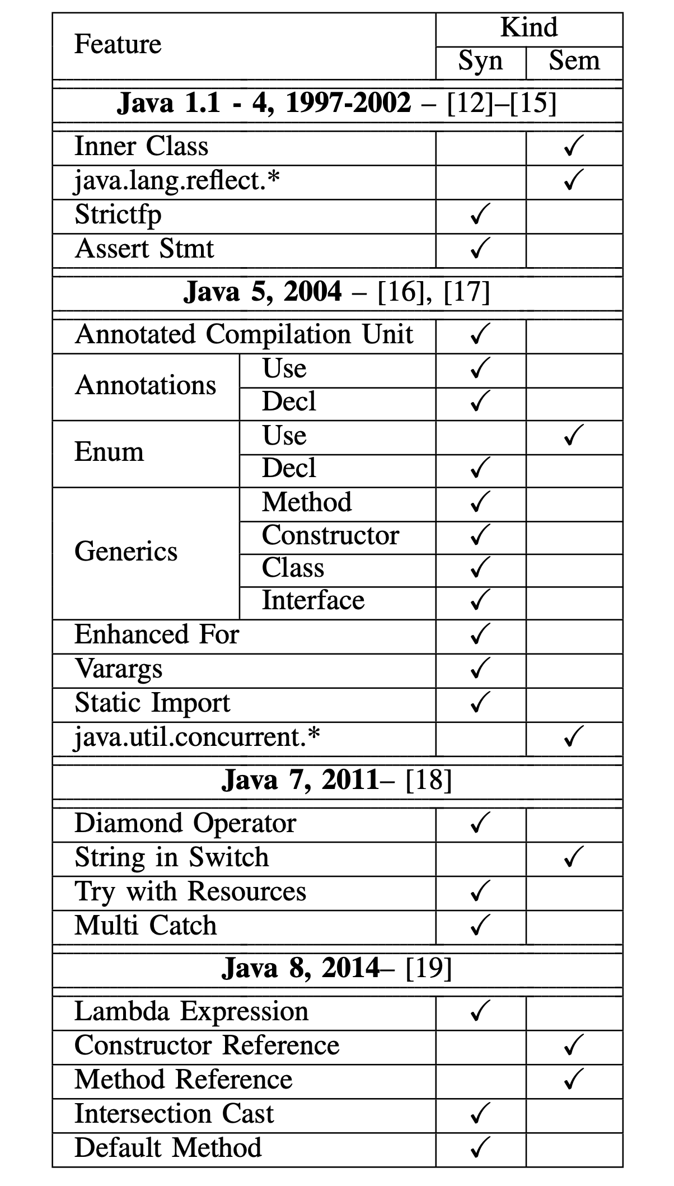
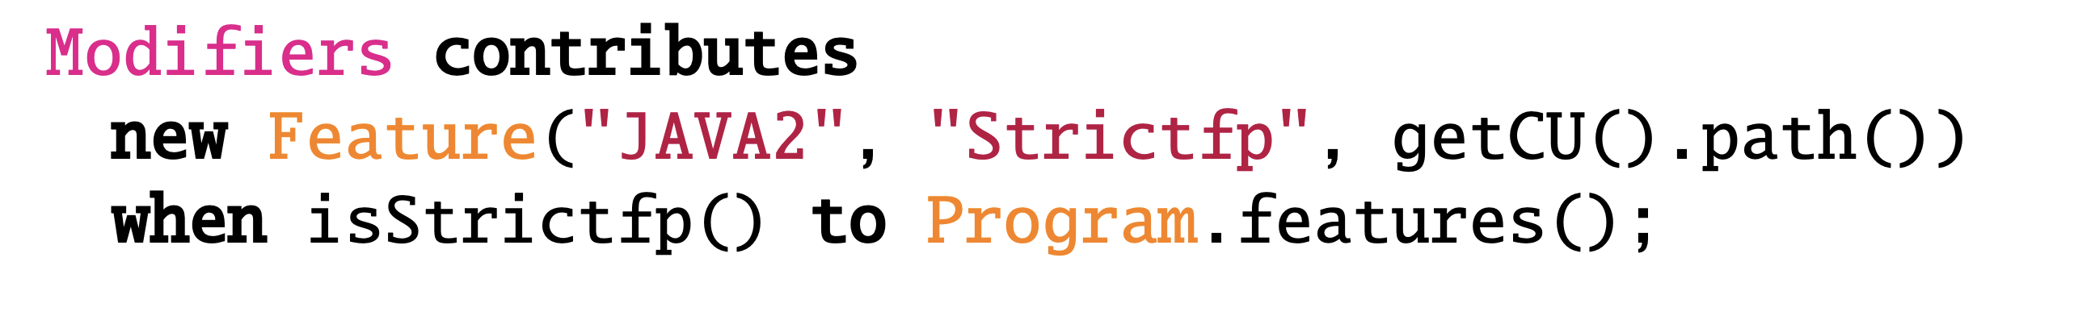
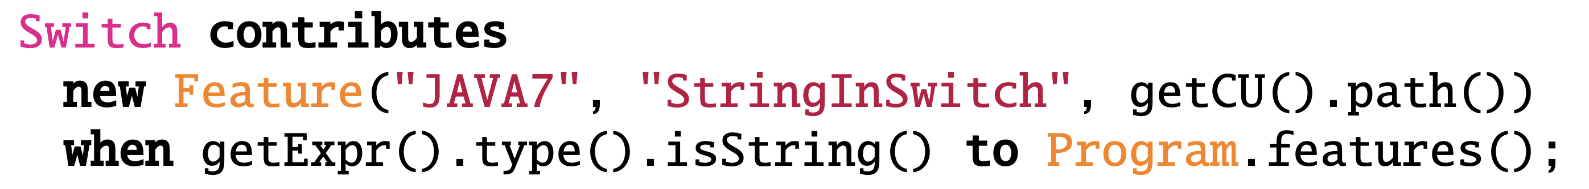
JFeature Decision support for selecting benchmarks for specific research questions for Java
Extract how often a Java feature is used
Analyse the source code
Declarative specification
Syntactic and semantic features (anything a compiler can typically compute)
Extensible

Slide 5
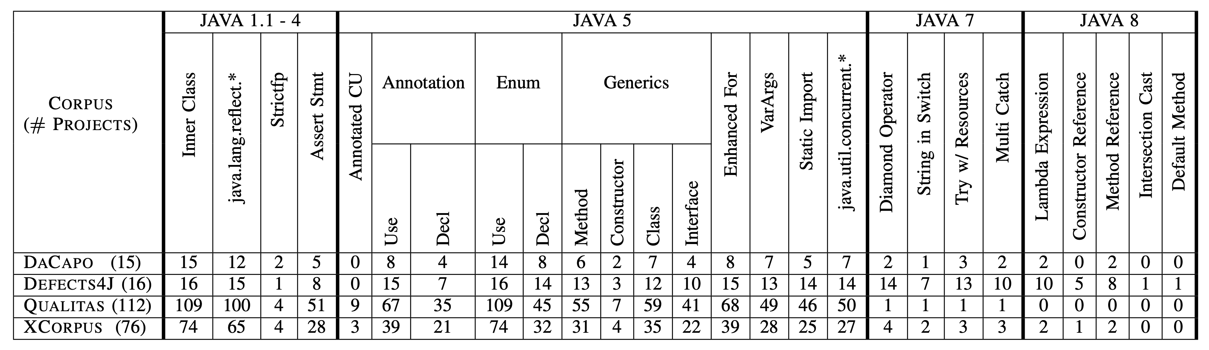
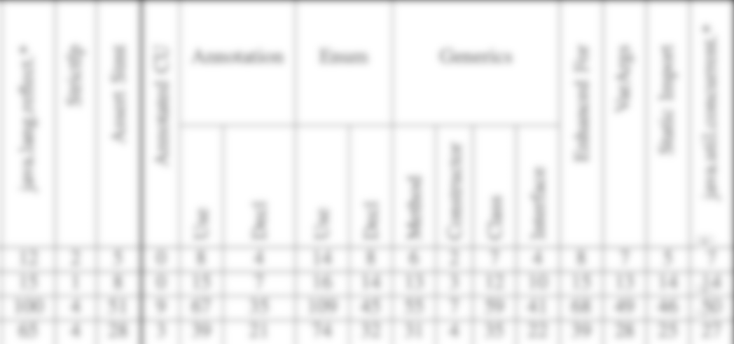
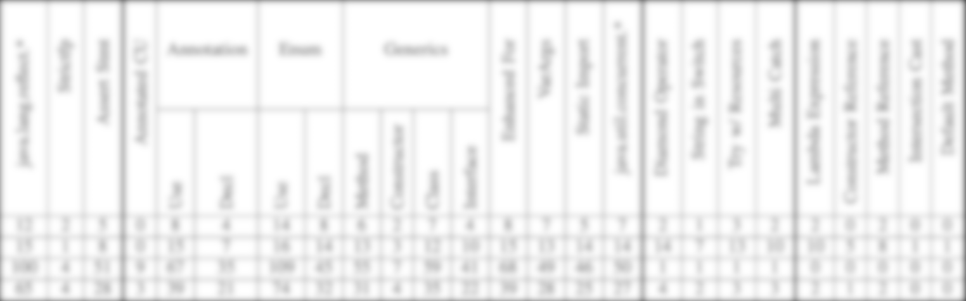


Empirical results On four well-known Java corpora
DaCapo
Performance
# Projects: 15
Defects4J
Static Analysis
# Projects: 16
XCorpus
Dynamic Language Feature
# Projects: 76
Qualitas Corpus
Static Analysis
# Projects: 112
More fine grained results in our paper

Slide 6

Take away
Use Defects4j to evaluate your Java 7 or Java 8 application.
Check if the corpus fits with your research questions
If not, build your own corpus.
Thank you!
Notes:
Rewrite first sentence in Take Away.

Slide 7
What is a software corpus ?
Collection of software projects
Fixed version
Targeting a specific programming language, e.g., Java, C++
Source-code or bytecode
Constructed for a particular purpose:
Testing specific properties, e.g., heavy use of concurrency
Complex control-flow

